Slide 1

COMPUTATIONAL FINANCE AND
FINANCIAL MANAGEMENT
Student: Trang Minh Dao | Prof. Dr. Elmar Lukas Assistant: Gordon Briest July 09, 2021

Slide 2

DATA
Assets:
Bitcoin (BTC-USD) Historical Prices.
Gold (GC=F) Stock Historical Prices.
Crude Oil(CL=F) Stock Historical Prices.
Currency: EUR
Timeframe: 2018-06-18 – 2021-06-18
Source: Yahoo Finance
Adjusted close prices, called prices in short
Frequency: BTC (365 days) vs Gold and Crude oil prices (business days)

Slide 3

PART I – TIME SERIES ANALYSIS

Slide 4
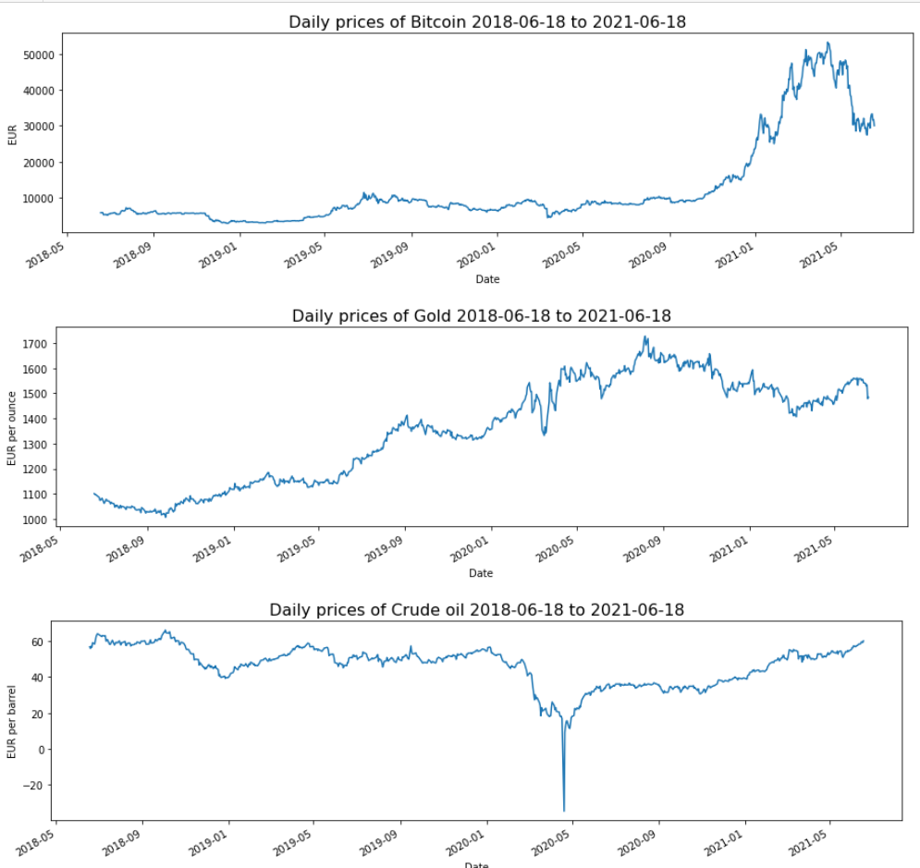
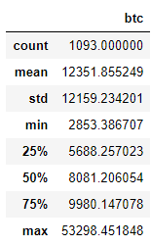
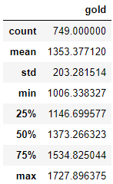
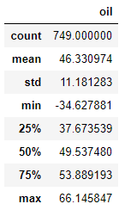
1. DESCRIPTIVE STATISTICS of PRICES

Slide 5
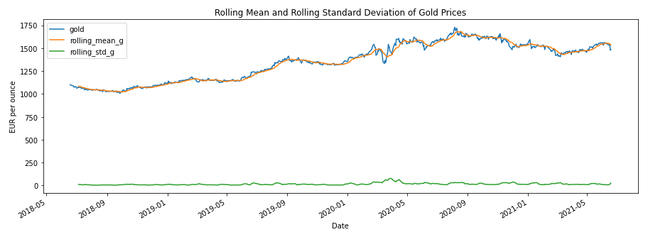
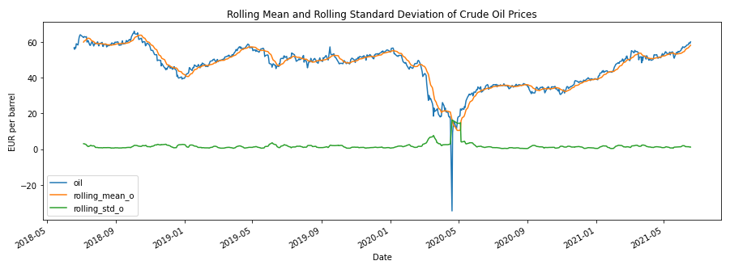
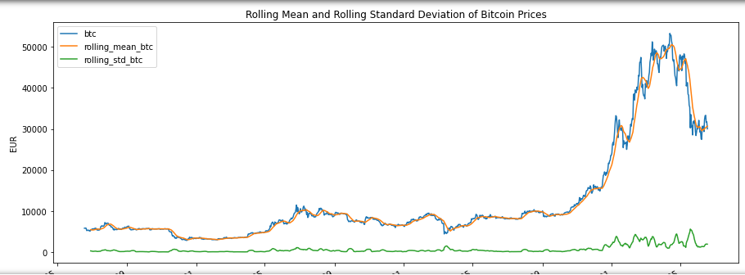
1. DESCRIPTIVE STATISTICS of PRICES
Rolling mean and variance of each series is not constant over the entire samples.

Slide 6
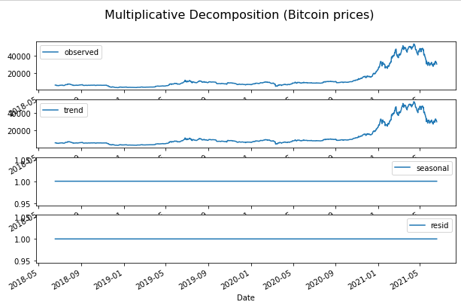
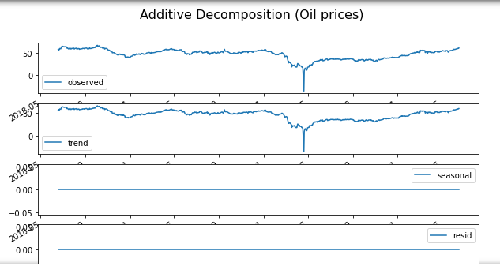
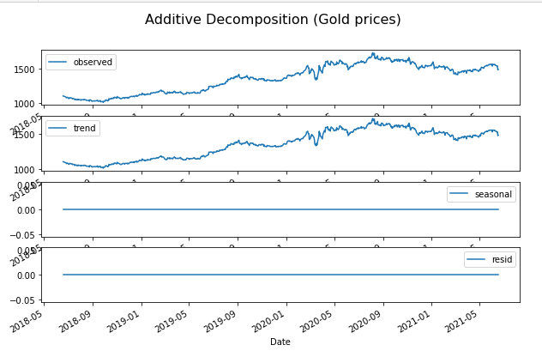
1. DESCRIPTIVE STATISTICS of PRICES
Decomposition:
no seasonality components
trend component has the same
pattern as the observed

Slide 7
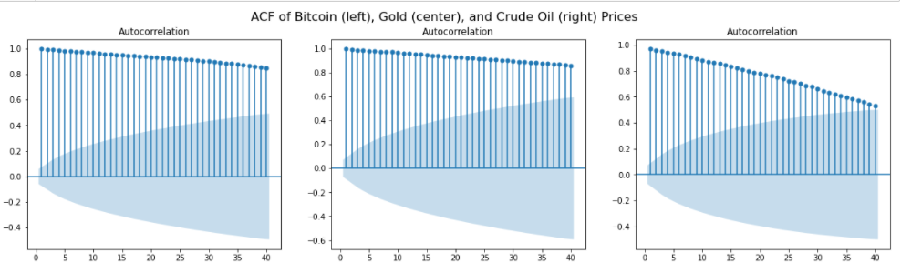
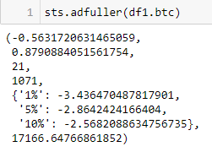
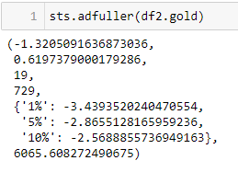
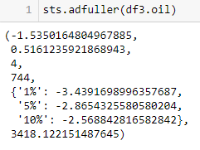
1. DESCRIPTIVE STATISTICS of PRICES
Stationarity evaluation:

Slide 8
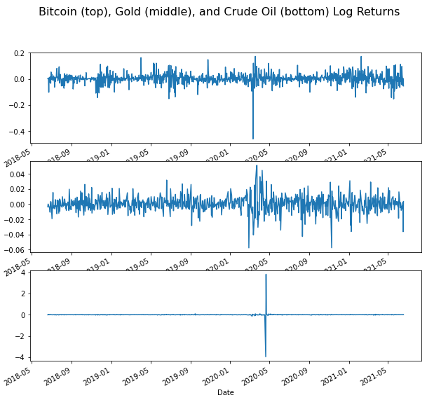
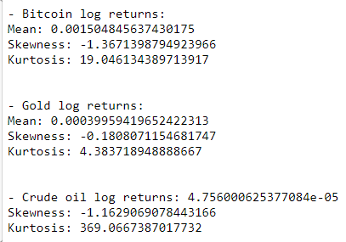
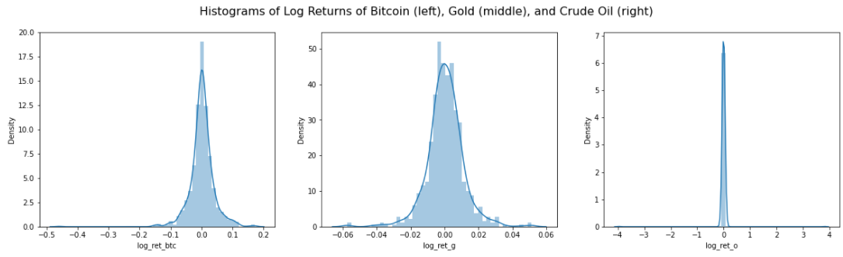

2. RETURNS
Log returns:

Slide 9
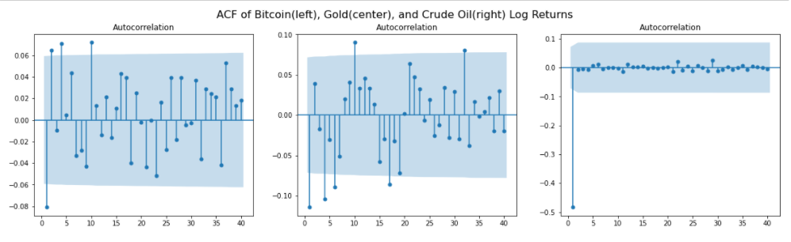
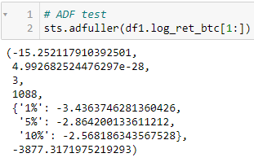
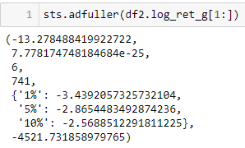
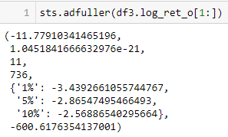
2. RETURNS
Log returns and stationarity evaluation:

Slide 10
3. MODEL SELECTION
Box-Jenkins Methodology
Model indentification - ACF, PACF
Model selection: Significant coefficients, AIC
Model checking: Residuals diagnosis
ARCH test
Shapiro-Wilks test
Ljung-Box test

Slide 11
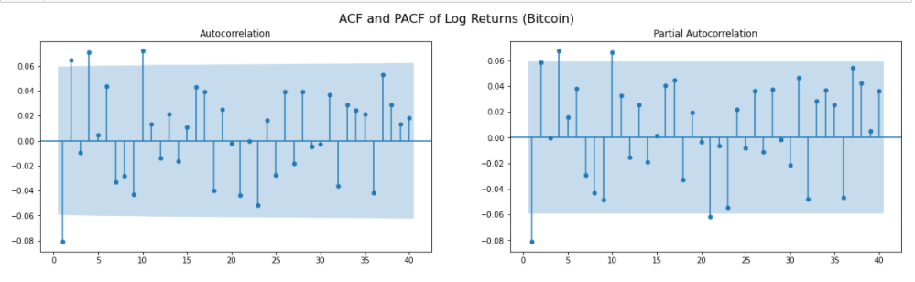
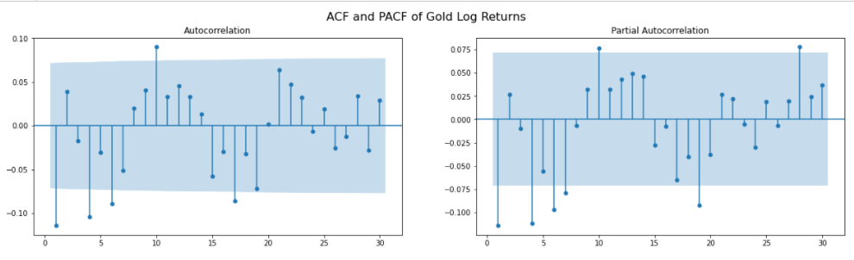
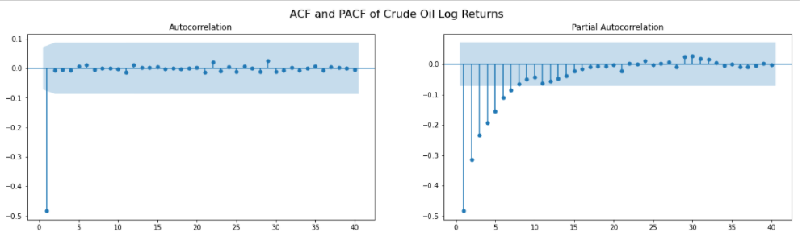
3. MODEL IDENTIFICATION
Bitcoin log returns:
from ARMA(1,1) to
ARMA(10,10)
Gold log returns:
- from ARMA(1,1)
to ARMA(7,6)
Crude oil log returns:
MA(1)

Slide 12
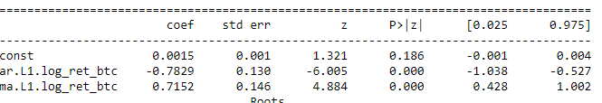
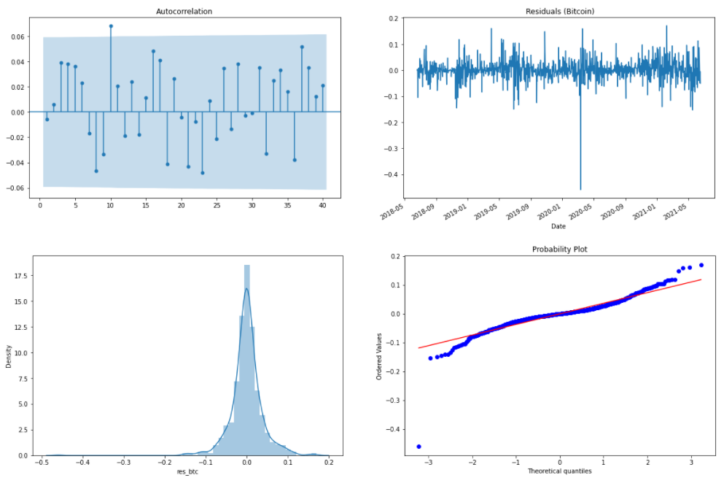

3. MODEL ESTIMATION
Bitcoin log return:
ARMA(1,1):

Slide 13
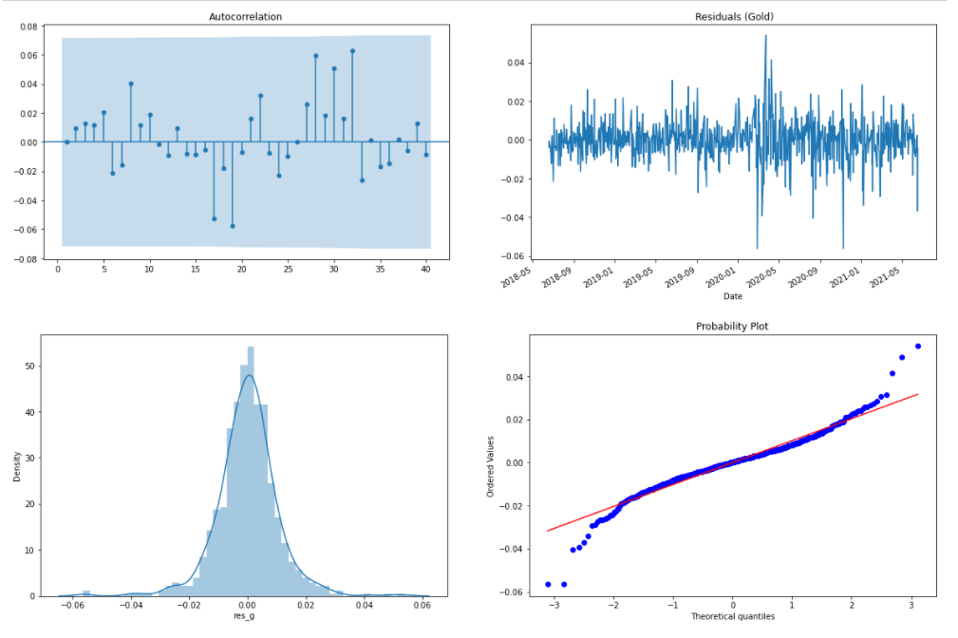
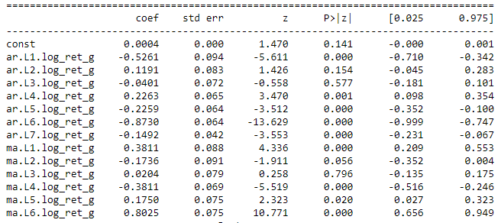
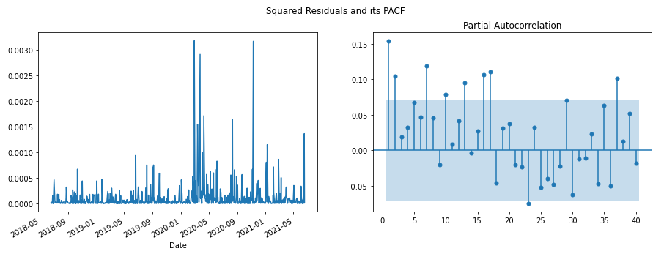
3. MODEL SELECTION
Gold log return:
ARMA(7,6):

Slide 14

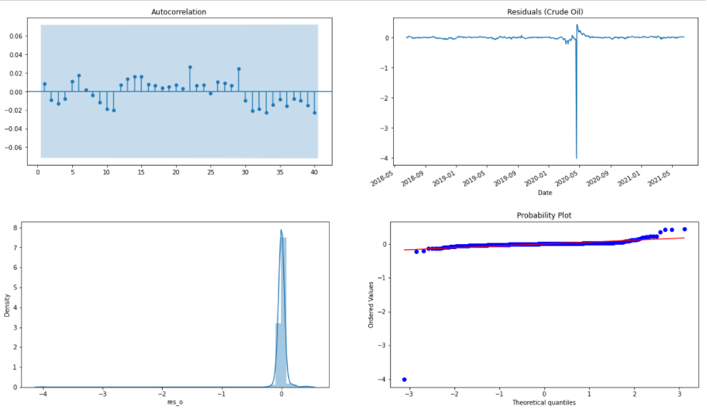

3. MODEL SELECTION
Crude oil log return:
MA(1)

Slide 15
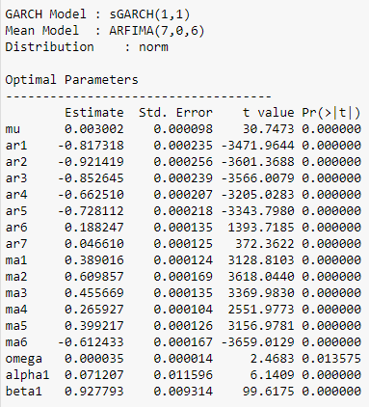
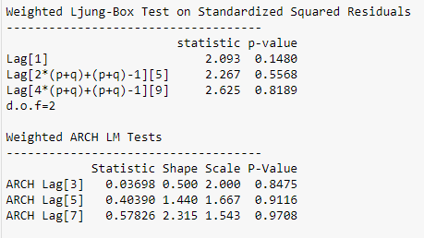
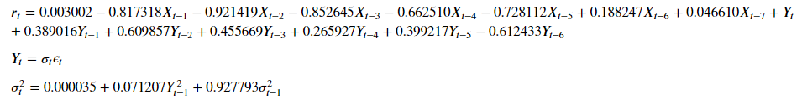
3. MODEL SELECTION
Gold log return:
ARMA(7,6) – GARCH(1,1):

Slide 16

4. CONCLUSION – TIME SERIES ANALYSIS
Characteristics of the time series:
Prices
Have trends & no seasonality, no repeating cycles in the series
Autocorrelation
Non-stationary
Volatility – Macro events
Returns: stationary with mean of 0
Models:
Bitcoin log returns: ARMA(1,1)
Gold log returns: ARMA(7,6)-GARCH(1,1)
Crude oil log returns: MA(1)

Slide 17
PART II
PORTFOLIO OPTIMIZATION

Slide 18

1. OVERVIEW
Modern portfolio theory by Harry Markowitz
Purpose:
Analyse the risk return profile
Find the tangency portfolio & the minimum variance portfolio
Assign weights/capital for assets
Budget constraint: : 100.000 EUR
Assets:
3 Risky assets: (Commodities) Bitcoin, Gold and Crude oil
Risk-free asset: U.S Treasure Bills

Slide 19
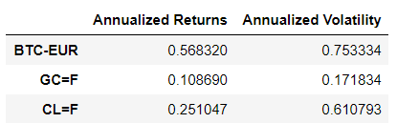
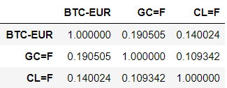
2. RISK-RETURN ANALYSIS
Annualized returns & Annualized volatility:
Correlation matrix:

Slide 20
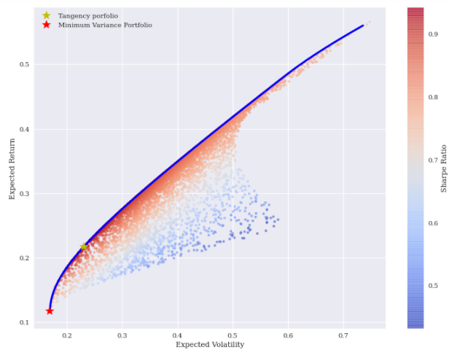
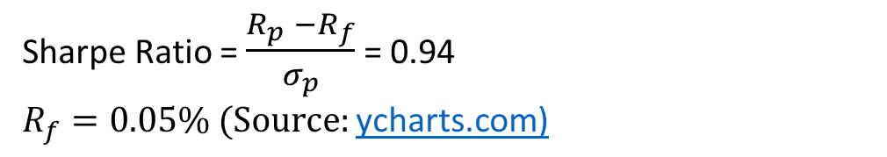
3. EFFICIENT FRONTIER
Monte Carlo simulation
Minimum variance portfolio
Weights
BTC-EUR | 0.004
GC=F | 0.949
CL=F | 0.047
Expected return: 0.117
Volatility: 0.169
Tangency portfolio
Weights
BTC-EUR | 0.204
GC=F | 0.688
CL=F | 0.109
Expected return: 0.218
Volatility: 0.231
Sharpe Ratio = $\frac{R_{p} −R_{f}}{σ_{p}}$ = 0.94
$R_{f}=0.05\%$ $(Source:\text{ycharts}\text{.}\text{com}\text{)}$

Slide 21
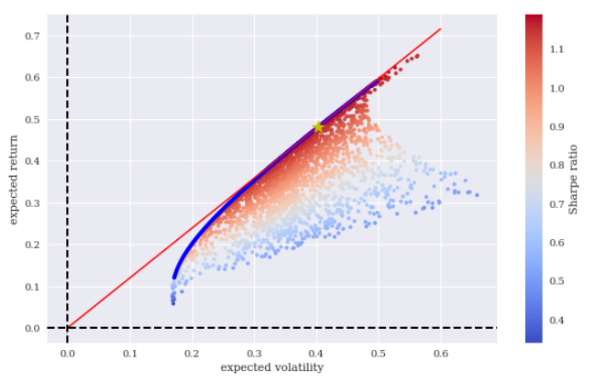
4. CAPITAL ALLOCATION LINE – SHARPE RATIO
Portfolio = Risk Free + Risky Portfolio
Budget: 100000 EUR Capital per asset
BTC – EUR | 204000 EUR
GC=F | 688000 EUR
CL=F | 109000 EUR

Slide 22

5. CONCLUSION - PORTFOLIO OPTIMIZATION
After checking the return-risk profile, with Monte Carlo simulation the efficient frontier is constructed, and then the tangential portfolio is the optimal portfolio with the maximum Sharpe ratio.
The expected return and the determined volatility are enough to characterize the optimal portfolio
Additional metrics: Correlation matrix
and Sharpe ratio

Slide 23
FINAL SUMMARY

Slide 24

REFFERENCES
Yves Hilpisch. Python for Finance, 2nd Edition
Chris Chatfield Haipeng Xing. The Analysis of Time Series An Introduction with R.
3 Month Treasury Bill Rate (ycharts.com)
The OPEC Annual report 2019, 2020: https://www.opec.org/opec_web/en/publications/337.htm
What Happened to Oil Prices in 2020 (investopedia.com)
Negative Oil Prices? They're Already Here
https://www.statsmodels.org/
https://pandas.pydata.org/
https://docs.scipy.org/doc/scipy/reference/
http://numpy.org/
https://matplotlib.org/stable/api/
Source of images and icons: https://www.freepik.com/

Slide 25
Q&A

